Slide 1


Today

Slide 2
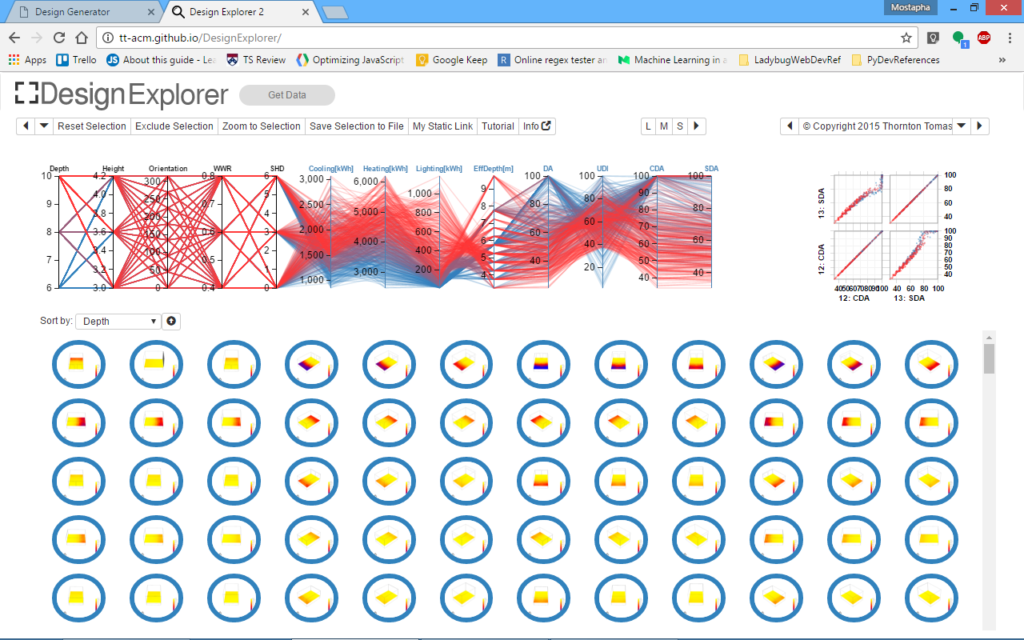

Slide 3

Design Generator

Slide 4
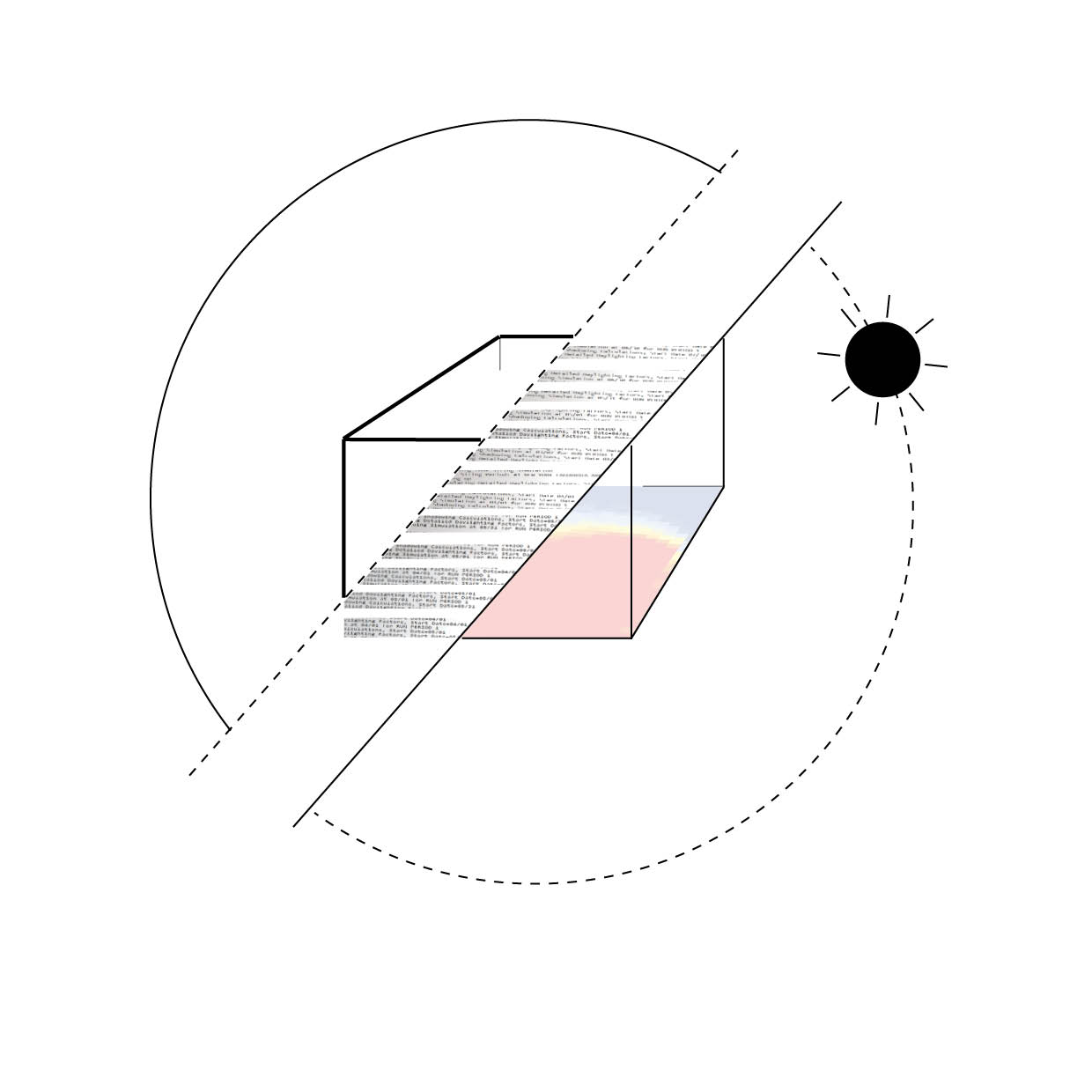

Slide 5

# of Floors
Area (m2)
Aspect Ratio
Perimeter Depth (m)
Orientation
Floor to Floor height (m)
Window Wall Ratio (%)
Window Height (m)
Sill Height (m)
Shading depth (m)
Infiltration
Wall R-value (M/K/W)
Roof R-value (M/K/W)
Glazing U-(W/m.k)
Glazing SHGC
Glazing VLT
Outside air (Core)
Outside air (Perimeter)
Internal Load (Core
Internal Load (Perimeter)
Heating Comfort Setpoint
Cooling Comfort Setpoint
HVAC System
2^23 = 8.4 million
3^23 = 94 billion

Slide 6
# of Floors
Area (m2)
Aspect Ratio
Perimeter Depth (m)
Orientation
Floor to Floor height (m)
Window Wall Ratio (%)
Window Height (m)
Sill Height (m)
Shading depth (m)
Infiltration
Wall R-value (M/K/W)
Roof R-value (M/K/W)
Glazing U-(W/m.k)
Glazing SHGC
Glazing VLT
Outside air (Core)
Outside air (Perimeter)
Internal Load (Core
Internal Load (Perimeter)
Heating Comfort Setpoint
Cooling Comfort Setpoint
HVAC System
6^4 = 1,296

Slide 7
# of Floors
Area (m2)
Aspect Ratio
Perimeter Depth (m)
Orientation
Floor to Floor height (m)
Window Wall Ratio (%)
Window Height (m)
Sill Height (m)
Shading depth (m)
Infiltration
Wall R-value (M/K/W)
Roof R-value (M/K/W)
Glazing U-(W/m.k)
Glazing SHGC
Glazing VLT
Outside air (Core)
Outside air (Perimeter)
Internal Load (Core
Internal Load (Perimeter)
Heating Comfort Setpoint
Cooling Comfort Setpoint
HVAC System
Statistics?
Machine Learning?

Slide 8
